Slide 1


National Core Indicators:
Using Data to Manage Public Systems
People with Disabilities Participating Fully and Safely in the Community Conference
Dublin, Ireland
October 13, 2011
Valerie Bradley
Human Services Research Institute
Cambridge, Massachusetts

Slide 2

What Will We Cover
Introduction and Background
History and Evolution of National Core Indicators
Brief Overview of NCI results for 2009-2010
How do public managers use NCI?
Lessons learned
Next Steps
Questions?

Slide 3

Why Should We Care About Quality?
We have created a movement and made promises to people with disabilities and their families
Ideology alone does not create a stable and
reliable system of supports
The greater the investment the greater the expectations
Unless we build quality in to any reform, it is very difficult to know whether our outcomes are achieved
We need early warning signs

Slide 4

NCI in a Nutshell
NCI is a multi-state collaboration of state ID/DD agencies interested in measuring how well public developmental disabilities systems serve and support people.

Slide 5

NCI Premise
Improving performance starts
with measuring performance –
if you don’t measure it, no guarantee that it will happen
NCI helps states to measure performance:
  Over time (change from baseline)
  Against multi-state benchmarks (our performance compared to performance elsewhere)

Slide 6
Overview of NCI
Launched in 1997 in 13 participating states; collaboration between the National Association of State Directors of Developmental Disabilities and the Human Services Research Institute
Currently 25 states and 4 sub-state regions
Unparalleled 13-year database on over 12,000 individuals
Addition of California almost doubles the numbers of individuals in the data base
Valid and reliable consumer survey that has been recently up-dated

Slide 7

History and Rationale
Systems becoming increasingly complex and more difficult to monitor
Quality measurement focused on rules and regulations that devalued individual experience
Importance of asserting the values and assumptions that create the foundation of ID/DD services
Voices of consumers becoming more powerful
Technology made data aggregation and analysis easier
Need to measure the impact of pending cutbacks

Slide 8
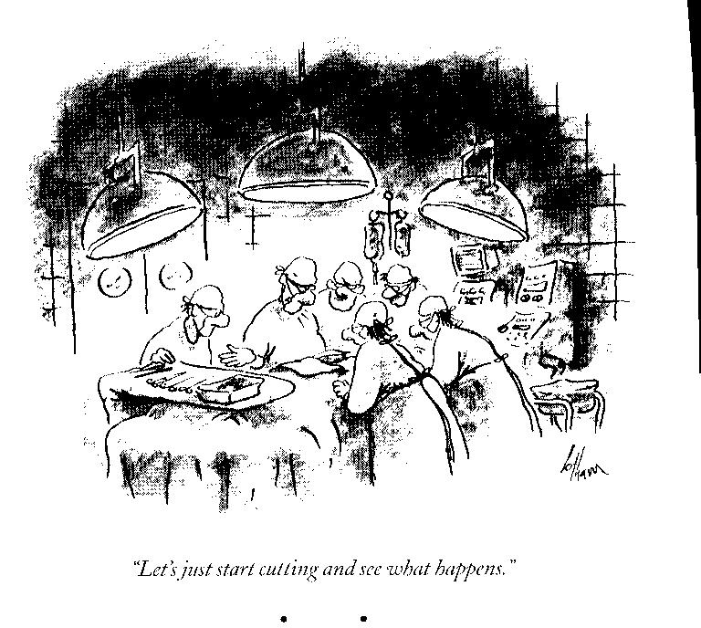

Slide 9
Without NCI. . .
States would be unable to create benchmarks and compare their performance with national and other state norms
Managers would not be able to distinguish between the aspirations in public policy and the actual outcomes of those policies as experienced by people with ID/DD and their families
Advocates and legislators would be unable to compare the effectiveness and outcomes of specific types of services
Managers and regulators would be unable to track important system changes – either negative or positive
Stakeholders would be unable to track the impact of system reform

Slide 10
With NCI. . .
Can measure and develop
strategic goals
Can enhance transparency
Can involve individuals and families in the interpretation of results
Can communicate system values – e.g., choice, health, relationships

Slide 11


Slide 12

Challenges
Agreement on what to measure
Integration of NCI into ongoing public quality enhancement efforts
Development of a valid and reliable tool that captures individual experience
Decisions about proxy responses
Reconciliation of disparate state service definitions and data collection protocols
Avoiding undue data collection burdens on the state
Educating other stakeholders on the value of the NCI data and how to use it
Survey fatigue

Slide 13

“The kid is good!”

Slide 14
NCI Participating States 2010-2011
NH
WA
ME
MA
SD
NY
PA
NJ
OH
IL
DC
CA
MO
KY
HI
NC
AZ
OK
AR
NM
AL
GA
TX
LA
FL

Slide 15

NCI Measures Offer a Unique View
Individual characteristics of people receiving services and support
The locations where people live
The activities they engage in during the day including whether they are working
The nature of their experiences with the supports that
they receive (e.g., with case managers, ability to make choices
The context of their lives – friends, community
involvement, safety
Health and well-being
15
Notes:
15
NCI provides a unique view on the experiences of individuals receiving support across a wide range of activities

Slide 16

What are the Core Indicators?
Consumer Outcomes:
  Employment
  Community Inclusion
  Choice and Decision-making
  Relationships
  Health and Safety

Slide 17

What are the Core Indicators?
Family Indicators
  Information and Planning
  Choice & Control
  Access & Support Delivery
  Community Connections
  Family Involvement
  Satisfaction
  Family Outcomes

Slide 18

What are the Core Indicators?
System Indicators
  Mortality
  Staff Turnover
  Incidents/Abuse/Neglect
  Restraints

Slide 19

What are the data sources?
Consumer Quality of Life Survey
  Face to face interview
  Random sample
  Adults only
Family Survey
  Adult Family Survey (at home, 18+)
  Family Guardian Survey (out-of-home)
  Children Family Survey (at home, <18)
System Indicators
  Specific protocols for reporting turnover, mortality and incidents

Slide 20
Where does NCI fit in?
One component of a Quality Management and Quality Improvement System
Widely-used process for measuring consumer and family quality of life
Included with other QA data in annual reports, CMS evidence packages & strategic planning
Some states also use NCI to measure county- and provider-level performance

Slide 21
Selected Findings
Consumer Survey
2009-2010

Slide 22
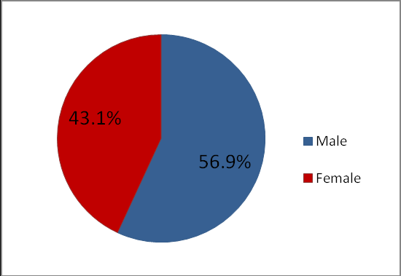
Gender

Slide 23
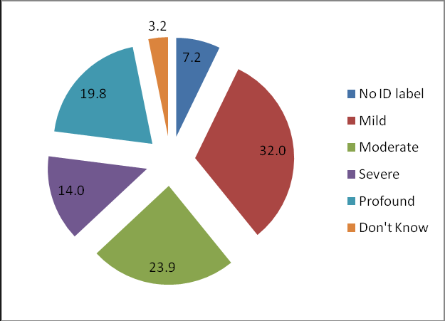
Level of Intellectual Disability

Slide 24
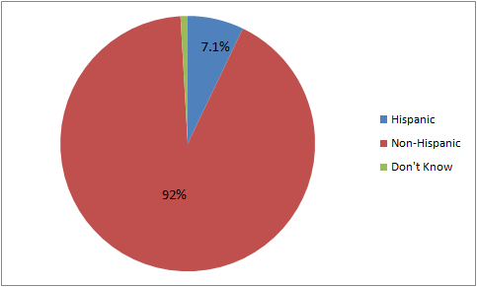
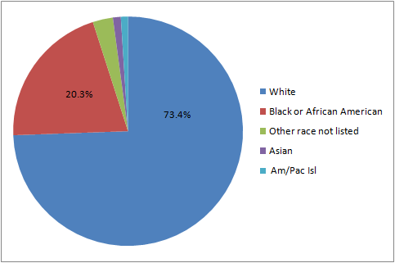
Race
Ethnicity
1.1%
1%
2.8%

Slide 25
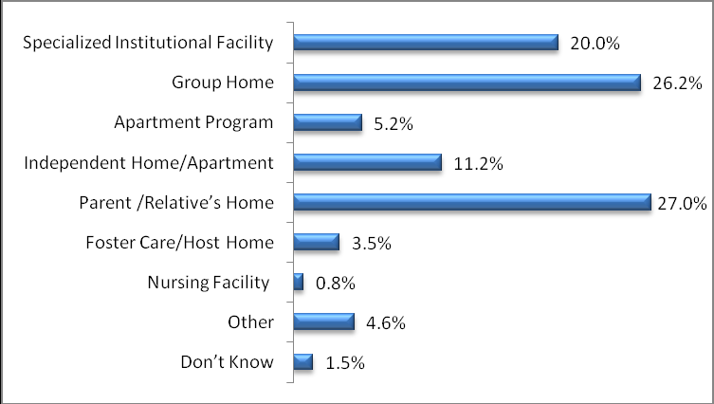
Where People Live (n=11,429)

Slide 26
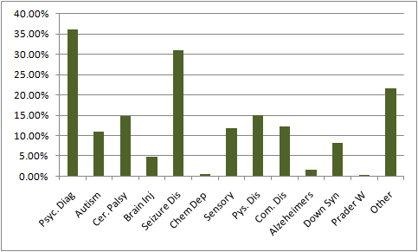
Other Disabilities

Slide 27
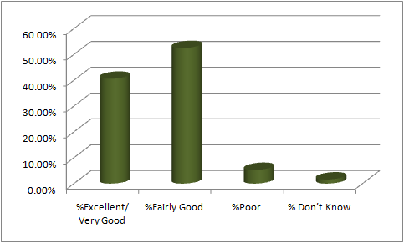
Overall Health

Slide 28


Choice of Where and With Whom to Live

Slide 29


Choice of Job, Activities

Slide 30


Choice of Free Time and Spending

Slide 31

Loneliness by Living Arrangement

Slide 32
Type of Community Job

Slide 33
Basic Exams & Screenings
Higher percentages in provider-based settings
Lowest for people living in parent/relative home
Similar trend across indicators

Slide 34
Vaccinations by Living Arrangement

Slide 35
Cancer Screenings by Living Arrangement

Slide 36

At Least One Psychotropic Medication

Slide 37

Use of Psychotropic Medications and Obesity

Slide 38

Lessons Learned and Next Steps

Slide 39

Lessons
The effort must continue to be relevant to the needs of public managers, individuals with disabilities, family members and other stakeholders
Don’t be too ambitious at the outset – take on measurements for which there is data readily available
Continue to improve the ease of data collection and data submission
Don’t use the information for compliance – it should be a tool for quality improvement

Slide 40
Next Steps
Potential use of NCI for health surveillance
Interactive website
Increased accessibility of the data to the public
Focus on improving data collection on abuse and neglect
Aligning NCI with other national data collection efforts
Expanding number of states with additional federal funding

Slide 41
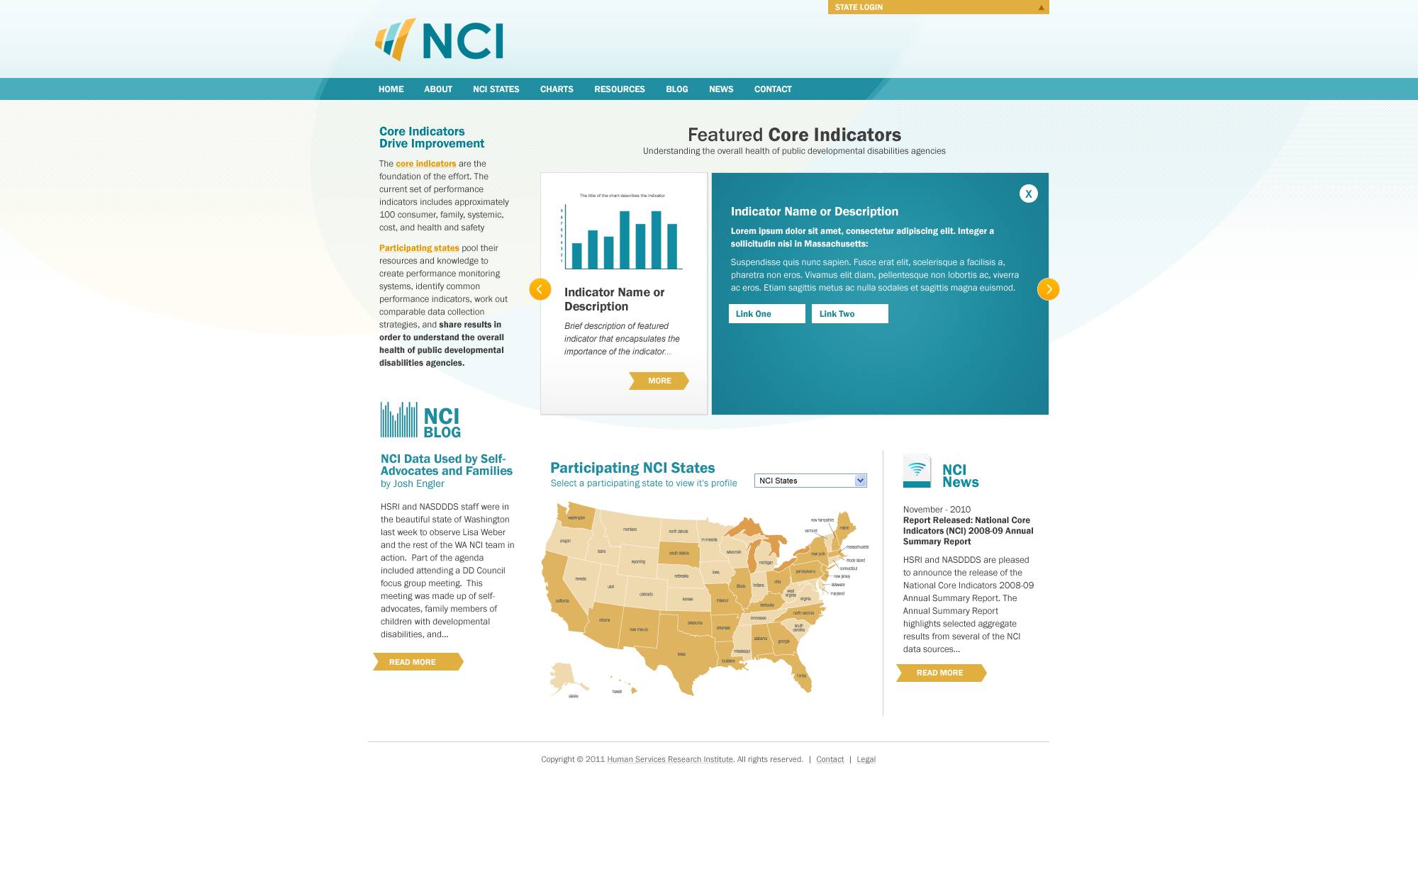
www.nationalcoreindicators.org

Slide 42

Questions?
What did she say?

