Slide 1
Race/Ethnicity and the Use of Preventive Care Among Adults with Intellectual and Developmental Disabilities

Slide 2
WHAT IS NATIONAL CORE INDICATORS (NCI)?
Multi-state collaboration of state DD agencies
Measures performance of public systems for people with intellectual and developmental disabilities
Assesses performance in several areas, including: employment, community inclusion, choice, rights, and health and safety
Launched in 1997 in 13 participating states
Supported by participating states
NASDDDS – HSRI Collaboration

Slide 3
WHAT IS NATIONAL CORE INDICATORS (NCI)?
Currently 35 states, the District of Columbia and 25 sub-state regions (including all CA Regional Centers)

Slide 4
WHAT IS NCI?
Adult Consumer Survey
Family Survey
Adult Family Survey (person lives at home; 18 and older)
Family Guardian Survey (person lives out-of-home; 18 and older)
Children Family Survey (child lives at home; under 18 years old)
Provider Survey
Staff Stability
System Data
Mortality
Incidents

Slide 5
WHAT IS NCI? Adult Consumer Survey
Standardized, face-to-face interview with a sample of individuals receiving services
Background Information
Section I (no proxies allowed)
Section II (proxies allowed)
No pre-screening procedures
Conducted with adults only (18 and over) receiving at least one service in addition to case management
Section I and Section II together take 50 minutes (on average)

Slide 6
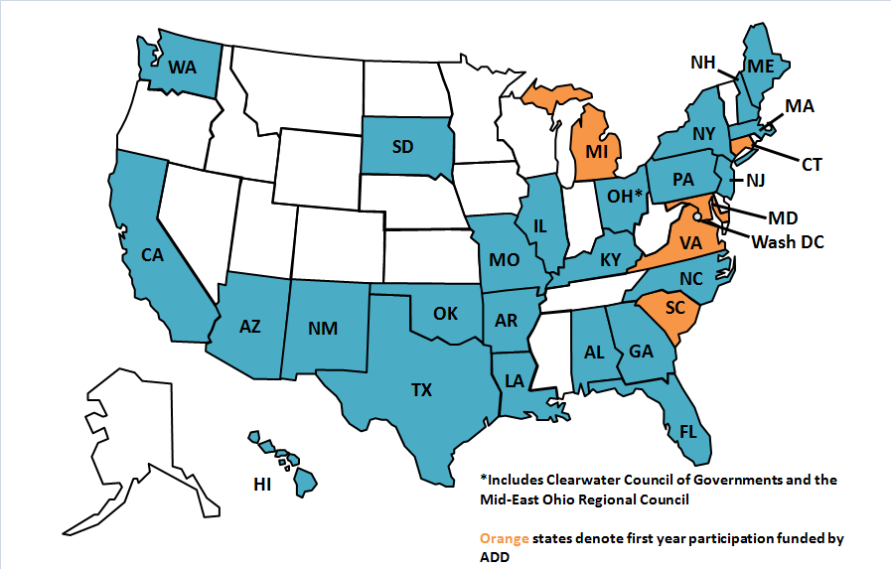
Methods, Measures and Sample: Data Source
Adult Consumer Survey (ACS), 2011-2012 data collection cycle
Background Information section: demographics, residence, health, and employment information. Generally collected from records by case managers.
19 states, one regional council
Total N: 11,224 individuals

Slide 7
Methods, Measures and Sample: Race/Ethnicity
Source: two items from Background Section
Ethnicity (Hispanic, or non-Hispanic)
Race (American Indian or Alaska Native, Asian, Black or African, American, Pacific Islander, White, or Other race not listed)
Items combined to create: Race/Ethnicity
White, Non-Hispanic
African American, Non-Hispanic
Hispanic
Other race/ethnic categories too small for analysis

Slide 8
Methods, Measures and Sample: Preventive Care
Person has a primary care doctor:
No
Yes
Last complete annual physical exam (routine):
In the past year
One year ago or more
Last dentist visit:
In the past year
One year ago or more
Last eye exam/vision screening
In the past year
One year ago or more

Slide 9
Methods, Measures and Sample: Preventive Care
Last hearing test:
Within the past 5 years
5 years ago or more (or never)
Flu vaccination in the past 12 months:
Yes
No
Ever had a vaccination for pneumonia:
Yes
No
“Don’t know” responses were excluded from these analysis – i.e. excluded from both denominator and numerator

Slide 10
FINDINGS

Slide 11
Race/Ethnicity of Sample
Race/Ethnicity | Frequency | Percent of total
African American, Non-Hispanic | 2,251 | 20.1%
Hispanic | 457 | 4.1%
White, Non-Hispanic | 8,516 | 75.9%
Total | 11,224 | 100.0%

Slide 12
Preventive Care: Primary Care Doctor (p < .001)

Slide 13
Preventive Care:
Physical Exam in Past Year (p < .001)
Dentist Visit in Past Year (p < .001)

Slide 14
Preventive Care:
Eye Exam/Vision Screening in Past Year (p < .05)
Hearing Test in Past Five Years
( p < .01)

Slide 15
Preventive Care:
Ever had pneumonia vaccine (p < .001)
Flu vaccine in past year (p < .001)

Slide 16
Preventive Care: Simple binary logistic regressions (odds ratios)
* p<.05, ** p<.01, ***p<.001

Slide 17
BUT:
Differences may be due to other demographic characteristics.
The following demographic variables were tested and found to be significantly different among the three racial/ethnic categories:
State
Age
Gender
Individual’s primary language
Individual’s primary means of expression
Level of intellectual disability
Mobility
Other diagnoses (in addition to ID/DD)
Poor health status
Support needed for behavioral issues
Residence type

Slide 18
Demographic Differences:
Average Age (p < .001)
Gender (p < .01)

Slide 19
Demographic Differences:
Primary language (p < .001)
Primary means of expression (p<.01)

Slide 20
Level of Intellectual Disability (p < .01)
Demographic Differences:

Slide 21
Mobility level (p < .001)
Demographic Differences:

Slide 22
Other diagnoses
Demographic Differences:

Slide 23
Demographic Differences:
Poor health status (p < .01)
Needs support to manage problem behavior (p < .05)

Slide 24
Residence Type (p < .001)
Demographic Differences:

Slide 25
Preventive Care: Multivariate Logistic Regressions
Coefficients for states not shown; * p<.05, ** p<.01, ***p<.001

Slide 26
Conclusions: Effect of race/ethnicity
There are differences in likelihood of receiving preventive care by race/ethnicity
White, Non-Hispanic respondents less likely to have a primary care doc
White, Non-Hispanic respondents more likely to have had a physical exam, a dental exam, a flu vaccination and/or a pneumonia vaccination
Adults with IDD of different racial/ethnic backgrounds also differ in other demographic factors
Where they live
Their age
Their means of expression
Their language
Their level of ID
Other diagnoses
Their level of mobility
Their health
It is crucial to control for these demographic factors.

Slide 27
Conclusions: Effect of race/ethnicity
Controlling for other demographic factors, racial/ethnic background is a significant predictor for :
Has had dentist visit in past year
African American, Non-Hispanic respondents are significantly less likely to have had a dentist visit in the past year
Has had eye exam in past year
African American, Non-Hispanic respondents are significantly more likely than White, Non-Hispanic respondents to have had an eye exam in the past year
Has had flu vaccine in past year
African American, Non-Hispanic respondents are significantly less likely than White, Non-Hispanic respondents to have had a flu vaccine in the past year
Controlling for other demographic factors, racial/ethnic background is no longer a significant predictor for:
Has primary care doctor
Has had physical exam in past year
Has had hearing test in the past five years
Has ever had pneumonia vaccine

Slide 28
Conclusions Other Findings
Speaking a language other than English has a negative effect on receipt of preventive care.
Residence type is strongly related to use of preventive care.
Individuals with less mobility are significantly more likely than those who are self-mobile (without using aids) to have been vaccinated against the flu and pneumonia.
Age is significantly related to receipt of physical exam, dentist visit and flu and pneumonia vaccines.
Being in poor health is a significant predictor of receiving flu and pneumonia vaccinations.
State in which individual resides is a highly significant predictor of receipt of all preventive care variables – much state to state variation.

Slide 29
Limitations
“Don’t know” responses are excluded from analyses. For some health care variables, the rate of “don’t know” responses are fairly high.
Data less likely to be available in independent/family home settings – i.e. higher rates of “don’t know” responses.
Choice is not taken into account - what if person does not want to get a specific test?
There may be other pertinent factors affecting likelihood of receipt of care that were not controlled for.
Standards regarding recommended frequency of care used are for general population.
No data on income or SES. Previous research has shown that racial/ethnic disparities are often confounded by disparities based on SES.

Slide 30
References
Ashton, C., Haidet, P., Paterniti, D., Collins, T., Gordon, H., O’Malley, K., Petersen, L., Sharf, B., Suarez-Almazor, M., Wray, N., Street, R. (2003). Racial and ethnic disparities in the use of health services: Bias, preferences or poor communication? J Gen Intern Med. 18:146-152
Bershadsky, J. & Kane, R. (2010). Place of residence affects routine dental care in the intellectually and developmentally disabled adult population on Medicaid. Health Services Res. 45(5 pt 1: 1376-89
Bershadsky, J., Taub, S., Bradley, V., Engler, J., Moseley, C., Lakin, K. C., Stancliffe, R. J., Larson, S., Ticha , R. & Bailey, C. (2012). Place of residence and preventive health care for developmental disabilities services recipients in twenty states. Public Health Reports, 127, 475-485.
Bonito, A., Eicheldinger, C., Lenfestey, N. (2005). Health disparities: Measuring health care use and access for racial/ethnic populations. Final Report, Part 2. Retrieved on March 4, 2013 from http://www.cms.gov/Research-Statistics-Data-and-Systems/Statistics-Trends-and-Reports/Reports/downloads/bonito_part2.pdf
Havercamp, S., Scandlin, D., Roth, M. (2004). Health disparities among adults with developmental disabilities, adults with other disabilities, and adults not reporting disability in North Carolina. Public Health Reports. 119 418-426
Jones, C. (2000). Levels of racism; A theoretic framework and a gardener’s tale. American Journal of Public Health. 90(8): 1212-1215
Kawachi, I., Daniels, N., Robinson, D. (2005). Health disparities by race and class: Why both matter. Health Affairs. 24(2):343-352
Magaña, S., Parish, S., Rose, R., Timberlake, M., Swaine, J. (2012). Racial and ethnic disparities in quality of health care among children with autism and other developmental disabilities. Intellectual and Developmental Disabilities. 50 (4) 287-299
Newacheck, P., Hung, Y., Wright, K. (2002). Racial and ethnic disparities in access to care for children with special health care needs. Ambulatory Pediatrics. 2 (2): 247-254

Slide 31
Contacts
HSRI
Julie Bershadsky: jbershadsky@hsri.org
Dorothy Hiersteiner: dhiersteiner@hsri.org
NASDDDS
Mary Lee Fay: MLFay@nasddds.org
NCI website: www.nationalcoreindicators.org

