Slide 1


National Core Indicators:
Outcomes and Services for Adults with Intellectual Disabilities
Sarah Taub, Human Services Research Institute
Roger J. Stancliffe, University of Sydney, University of Minnesota

Slide 2
1. National Core Indicators: Development, current use and future expansion

Slide 3
NCI Beginnings
Key factors then…and now
Need to control costs – managed care
Increased demand for accountability and transparency
Changes in how we define quality
  Outcomes important to people we serve
  Greater emphasis on choice and control
  Less focus on physical settings

Slide 4
NCI Beginnings
Major development activities
Gathering of 15 states in 1997
Six field-test states
Facilitated by NASDDDS and HSRI
Criteria-based selection of performance indicators
  Reflect goals that can be influenced by system
  Face validity: relevant to major stakeholders
  Directional: represent change over time

Slide 5
NCI Indicator Framework
Individual Outcomes
Employment
Choice & Control
Family Indicators
Information & Planning
Access to Supports
Health, Welfare, & Rights
Health & Wellness
System Performance
Service Coordination
Incidents & Mortality
Relationships
Community Connections
Safety
Respect & Rights
Choice & Control
Community Inclusion
Staff Turnover
= Adult Consumer Survey

Slide 6
NCI Adult Consumer Survey
Developed with Technical Advisory Group
Semi-structured, face-to-face interview
No pre-screening of respondents
Proxies allowed to answer certain questions
High inter-rater reliability
Standard training protocols
Variety of interviewers used to administer survey

Slide 7
Funding and Future Expansion
Primarily funded by public IDD state agencies
State participation is voluntary
Federal Administration on IDD recently awarded funding for 5-year expansion
Provides first-year seed money for 5 states/territories per year

Slide 8
NCI Participating States 2010-2013
NH
WA
ME
MA
OR
WI
NY
SD
RI
MI
PA
NJ
CT
OH
IL
IN
MD
UT
VA
DC
CA
MO
KY
HI
NC
AZ
OK
AR
SC
NM
MS
AL
GA
TX
LA
FL
2010-11 24 States
2011-12 29 States
2012-13 35 States

Slide 9
Expanded Uses of NCI
Original goal: tool for state public managers
  National and state-to-state benchmarking
  Tracking outcomes over time
  System-level quality improvement
Collaboration with researchers at U of MN
  Large multi-state database with randomly drawn state samples allows for multivariate analyses
  Research studies conducted with support from CMS, NIDRR, and AIDD

Slide 10
2. Examples of policy-relevant analyses using NCI data

Slide 11

Choice of Living Arrangements
Article 19a of the UN Convention on the Rights of Persons with Disabilities (United Nations, 2006) states:
  “Persons with disabilities have the opportunity to choose their place of residence and where and with whom they live on an equal basis with others and are not obliged to live in a particular living arrangement”.

Slide 12


Choice of Living Arrangements
POLICY IMPLEMENTATION QUESTION
  Overall
  What percentage of adult service users living outside the family home choose where and with whom they live?

Slide 13
Overall NCI Choice Results 2008
6778 adult developmental disabilities service users living in non-family-home
service settings in 26 US states

Slide 14


CONCLUSION
Most people have no choice of where to live (55%) or whom to live with (59%).
Policies endorsing choice of living arrangements are not being implemented satisfactorily.

Slide 15


Choice of Living Arrangements
POLICY IMPLEMENTATION QUESTION
  Does choice of living arrangements vary by residence type and level of disability?

Slide 16
Choosing Whom to Live With (person chose) by Level of Disability and Residence Type

Slide 17


CONCLUSION
People with severe/profound intellectual disability had little or no choice of whom to live with, regardless of residence type.

Slide 18
Choosing Whom to Live With (person chose) by Level of Disability and Residence Type

Slide 19
CONCLUSIONS
For people with mild and moderate intellectual disability, choice of living companions varies dramatically by residence type:
    own home (73.5% and 57.3% chose)
    group home (9.5% and 9.7% chose)
These findings support policies promoting individualised settings, such as one’s own home or an agency apartment.
  These settings do provide substantially more choice about living arrangements, as intended.

Slide 20
Wellbeing and Choice of Living Arrangements

Slide 21
Choice of Living Arrangements
POLICY IMPLEMENTATION QUESTION
  Does exercising choice of living arrangements lead to greater wellbeing?

Slide 22
NCI Wellbeing Outcomes
Loneliness
Feeling happy
At Home
Feeling afraid at home
Feeling afraid in your neighborhood
Home staff nice and polite
Liking home

Slide 23
Self-Report Data Only
Well-being items come from Section I of the NCI Consumer Survey, which may only be completed by interviewing the person receiving services. Due to communication difficulties, some service users could not take part in the interview.
Only included participants who were judged by interviewers to have given valid and consistent interview responses.
These selection criteria yielded predominantly people with mild or moderate ID.

Slide 24
Loneliness the most widespread problem

Slide 25
Results Summary
Personal characteristics controlled statistically in all comparisons.
Item | Chose Who to Live with | Chose Where to Live
Loneliness | 
Feeling happy |  | 
Afraid at home
Afraid in neighbourhood
Home staff nice |  | 
Like home |  | 

Slide 26
Conclusion
Choosing where to live and whom to live with each are associated with:
  multiple wellbeing benefits and
  no wellbeing detriments.

Slide 27
Self-Report Data

Slide 28
Self-Reporting
Questions about choice (e.g., where and with whom to live) come from Section II of the NCI Consumer Survey.
Section II questions may be completed by interviewing the person or a knowledgeable proxy. Information source for each item is recorded so that it is clear who answered each question.
This practice allows for a self-report variable to be included in regression analyses to estimate the effect of self-report vs proxy respondents.

Slide 29
Variability Associated with Self-Reporting
Nagelkerke Pseudo R-Square Change by Independent Variable Block

Slide 30
Conclusion
In these analyses self-reporting had a very small (where live) or negligible (whom live with) effect on choice data.
In some circumstances it may be acceptable to combine self-report and proxy data,.
If data source (self-report/proxy) is entered into the analysis as an independent variable it seems possible to control for and estimate the magnitude of the effect of self-reporting.

Slide 31
Obesity

Slide 32
Relative Disadvantage
POLICY IMPLEMENTATION QUESTION
Do people with intellectual disability experience relative disadvantage compared to the general community?
  Comparison of outcomes for people with intellectual disability with those experienced by the general community.

Slide 33
Approaches to Comparing Outcomes
Comparison
NCI outcomes vs available population data (e.g., obesity)
Survey general community using NCI (e.g., Kentucky: Sheppard-Jones, Prout, & Kleinert, 2005)

Slide 34
Overall Results: 8,911 adult NCI participants (age 20+) from 20 states
Normal weight (BMI < 25) = 37.8%
Overweight (25.00 ≤ BMI < 30.00) = 28.4%
Obese (BMI ≥ 30.00 ) = 33.8%

Slide 35

How Do These Results Compare to Other American Adults?
We compared our data with 2007-08 U.S. general population comparison data (age 20+) from:
  Flegal K.M., Carroll, M.D., & Ogden C.L., & Curtin L.R. (2010). Prevalence and trends in obesity among US adults, 1999-2008. JAMA, 303(3), 235-241.

Slide 36
% Obese (BMI ≥ 30.0):
Means and 95% CI, US vs NCI

Slide 37
% Obese (BMI ≥ 30.0):
Means and 95% CI, US vs NCI

Slide 38
Obesity (BMI ≥ 30.0)
NCI sample vs. U.S. general population
  No significant differences in obesity prevalence
All people
  NCI (33.6%) US (33.8%)
Men
  NCI (29.4%) US (32.2%)
Women
    NCI (38.9%) US (35.5%)

Slide 39
Policy Conflicts: When Outcomes Reveal a Mixed Pattern of Benefits
Obesity and Living Arrangements

Slide 40
% BMI Category by Residence type:
All participants

Slide 41
% BMI Category by Residence Type:
Mild ID only

Slide 42

Conclusions
We have shown elsewhere that smaller, less regulated settings, such as living in one’s own home, are consistently associated with desirable outcomes:
  greater wellbeing
  greater choice
  less loneliness
whereas institutions are associated with poorer outcomes.
Finding effective ways for people to maintain a healthy weight while living in community settings of their choice presents a challenge for all Americans, both those with and without ID.

Slide 43
3. How is NCI Data Used by States?

Slide 44
Overview of NCI Use at State Level
Overall quality management
  Set priorities for quality improvement
  Report evidence to federal funders (CMS Assurances)
Report results to stakeholders
  Internal state staff
  Quality councils/review committees
  State legislatures
  Providers
  Individuals and families receiving services

Slide 45

Examples of State Applications
http://www.mass.gov/eohhs/docs/dmr/qa-qina-preventive-screenings.pdf
Massachusetts Quality & Risk Management Briefs
  Preventive screenings
  Rights
  Choice

Slide 46
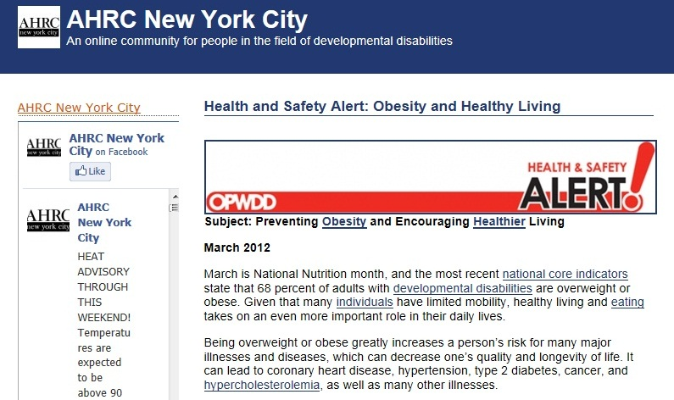
Examples of State Applications
http://ahrcnyc.wordpress.com/2012/03/06/health-and-safety-alert-obesity-and-healthy-living/

Slide 47
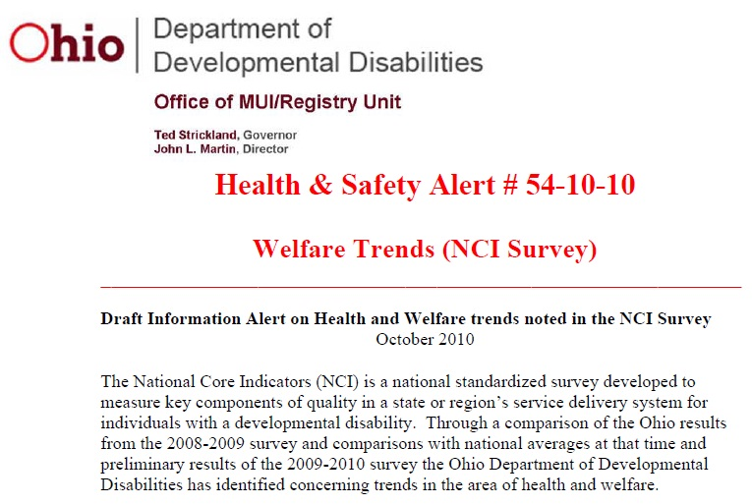
Examples of State Applications
http://test.mr.state.oh.us/health/documents/Alert54-10-10.pdf
Highlights areas for improvement based on data trends over time and comparisons with benchmarks (physical exam, dental exam, flu vaccine)
Provides recommendations and resources

Slide 48

Examples of State Applications
Kentucky Health and Wellness Initiative
Quality Improvement Committee (QIC) convened in 2012
Identified health and exercise as target area
Provided training to providers, students, faculty, community-based organizations
Initiative funded 8 pilot programs promoting inclusive physical fitness and healthy eating activities

Slide 49
Expanding Public Use of NCI Data
Evidence-Based Policy Initiative – collaboration between NASDDDS and AUCD
Research policy and process for requesting data and/or tools
  Formal process through NASDDDS Research Committee
  Several university researchers and students approved and currently working with data (autism, aging, health)
New website with chart generator feature

Slide 50
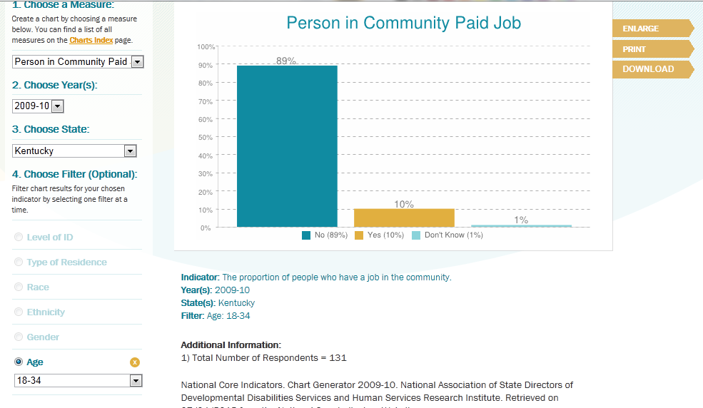
Chart Generator
www.nationalcoreindicators.org

Slide 51
4. Future Developments in Analyses of NCI Data

Slide 52
Policy Analyses and Outcomes
Grouping states by common policies to evaluate the impact of these polices on service provision and client outcomes. This may include multi-level modelling with state as one level of analysis.
EXAMPLE
Hewitt et al. (2011) compared the proportion of state ID/DD service users with and autism/ASD diagnosis by state autism/ASD service eligibility policies:
ASD Policies | No. of States | % service users with ASD diagnosis
None | 6 | 6.6%
Related condition (RC) | 14 | 8.4%
RC + autism –specific HCBS | 5 | 9.3%
x²(2, 12,382)=17.39, p<.001
Notes:
A related condition clause means that people with autism/ASD as well as other specified conditions are specifically identified by disability category as eligible for the state’s developmental disability services provided they meet functional skill and IQ limitations.
Autism-specific HCBS waiver which means that in order to be eligible for these services the person has to have a diagnosis of autism/ASD and have functional skill limitations.

Slide 53
Future Analyses of NCI Data
Longitudinal analyses.
Comparisons with the general community (like obesity analyses).
Additional outcomes – Employment, physical activity, social relationships, rights, medication use.
Different sub-groups – Older adults, people with cerebral palsy, women with autism.

Slide 54
OVERALL CONCLUSION
Regular assessment of outcomes experienced by adults with intellectual disability facilitates evaluation of:
  Benefits to service users
    Benefits of different service types
    Benefits to service users with different characteristics
  Policy implementation and effects
  Relative disadvantage compared to the general community.
Countries that do not currently have a national system for assessing outcomes should examine the NCI for its local applicability.

Slide 55
Contact Details
Roger J. Stancliffe
Professor of Intellectual Disability
Faculty of Health Sciences
The University of Sydney
AUSTRALIA
roger.stancliffe@sydney.edu.au
Sarah Taub
Senior Policy Specialist
Human Services Research Institute
Cambridge, MA 02140
USA
staub@hsri.org

Slide 56
References
Sheppard-Jones, K., Prout, H., & Kleinert, H. (2005). Quality of life dimensions for adults with developmental disabilities: A comparative study. Mental Retardation, 43, 281-291.

